Slide 1
Introduction to Machine Learning
Biochem 3BP3
Katie Houlahan, PhD
November 19, 2024

Slide 2


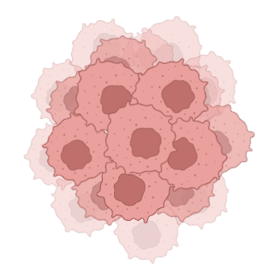


Machine Learning
RNA
MODEL

Slide 3
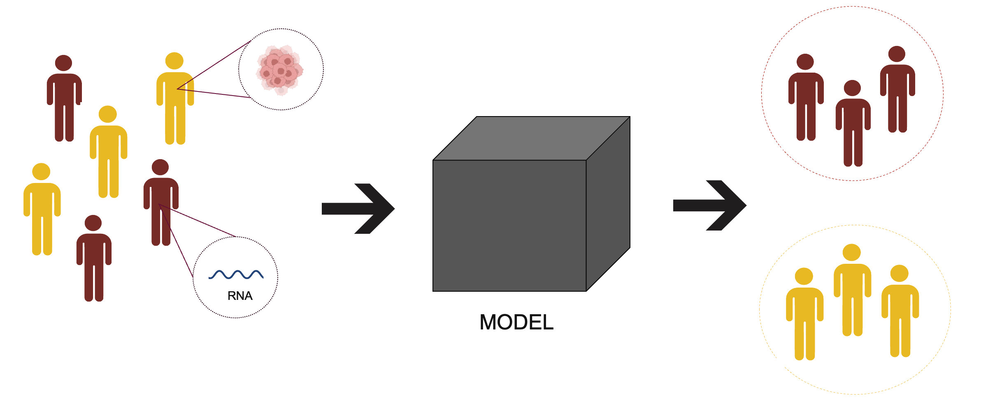
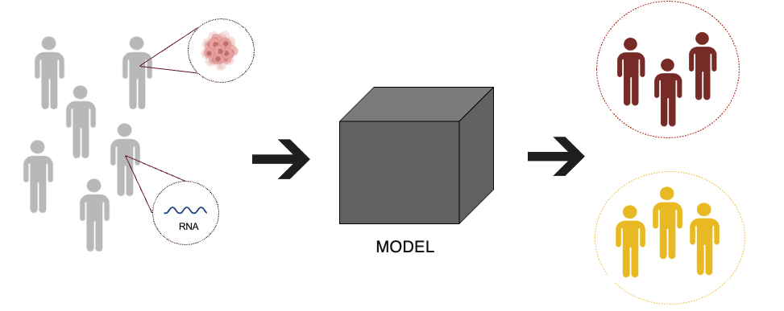
Types of learning
Machine Learning
Supervised Learning
Unsupervised Learning
Labeled Data
Unlabeled Data

Slide 4
Types of learning
Machine Learning
Supervised Learning
Unsupervised Learning
Labeled Data
Unlabeled Data

Slide 5
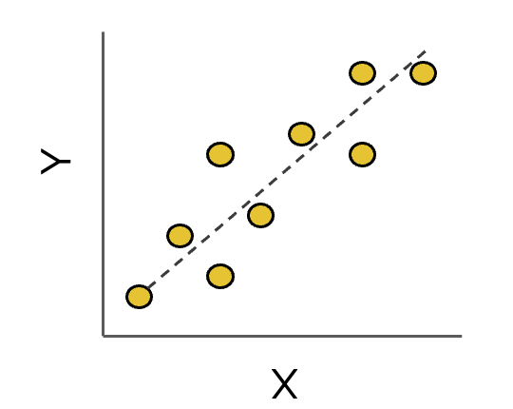
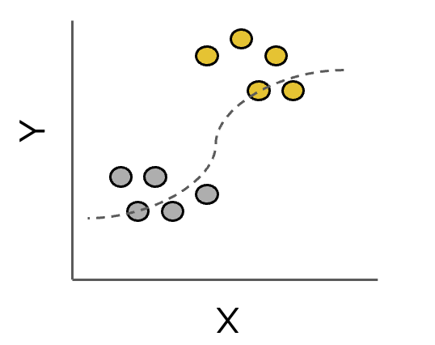
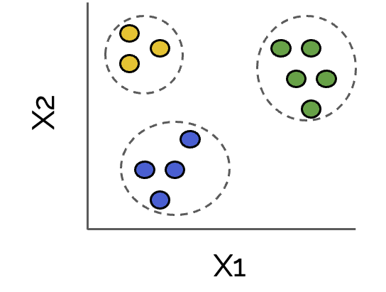
Types of learning
Machine Learning
Supervised Learning
Unsupervised Learning
Regression
Classification
Clustering

Slide 6
Types of learning
Machine Learning
Supervised Learning
Unsupervised Learning
Regression
Classification
Clustering

Slide 7
Types of learning
Machine Learning
Supervised Learning
Unsupervised Learning
Regression
Classification
Clustering

Slide 8
Linear regression
(65,73)
Y
0 10 20 30 40 50 60 70 80
(5,10)
0 10 20 30 40 50 60 70 80
X

Slide 9
Linear regression
(65,73)
(100,?)
Y
0 10 20 30 40 50 60 70 80
New point
(5,10)
0 10 20 30 40 50 60 70 80
X

Slide 10
Linear regression
Slope
Y = β₀ + β₁X
(65,73)
(100,?)
Intercept
Y
0 10 20 30 40 50 60 70 80
New point
(5,10)
0 10 20 30 40 50 60 70 80
X

Slide 11
Linear regression
105
Slope
Y = β₀ + β₁X
(65,73)
(100,105)
Intercept
100
Y
0 10 20 30 40 50 60 70 80
New point
(5,10)
0 10 20 30 40 50 60 70 80
X

Slide 12
Linear regression
Slope
In practice, β₀ and β₁ are unknown.
How do we find them?
Y = β₀ + β₁X
(65,73)
Intercept
Y
0 10 20 30 40 50 60 70 80
Estimate from your data.
(5,10)
0 10 20 30 40 50 60 70 80
X

Slide 13
Linear regression
12
Y = β₀ + β₁X
(65,73)
Y_{observed} = 31
15
Y
Y_{expected} = 12
0 10 20 30 40 50 60 70 80
(15,31)
ε_{i}
ε_{i} = Y_{observed} - Y_{expected}
(5,10)
ɛ=∑_{i=1}ɛ_{i}²
^{Sum of squares}
0 10 20 30 40 50 60 70 80
X

Slide 14
Linear regression
12
Y = β₀ + β₁X
(65,73)
Y_{observed} = 31
15
Y
Y_{expected} = 12
The least squares approach selects β₀ and β₁ to minimize the sum of squares
0 10 20 30 40 50 60 70 80
(15,31)
ε_{i}
ε_{i} = Y_{observed} - Y_{expected}
(5,10)
ɛ=∑_{i=1}ɛ_{i}²
^{Sum of squares}
0 10 20 30 40 50 60 70 80
X

Slide 15
Generalized structure of machine learning models
When building a predictive model, we assume a relationship between what we are trying to predict (Y) and our features (X), such that:
Y = f(X) + e
Our goal is to develop f^(X) ≈ f(X)
Models are trained and tuned by minimizing error

Slide 16
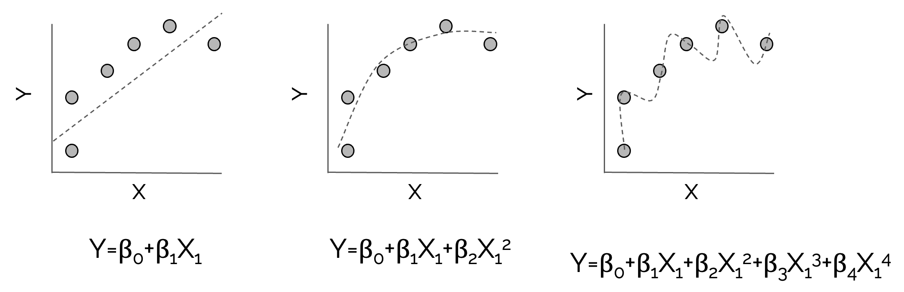
Linear regression

Slide 17
Linear regression
High Bias
Just Right
High Variance

Slide 18
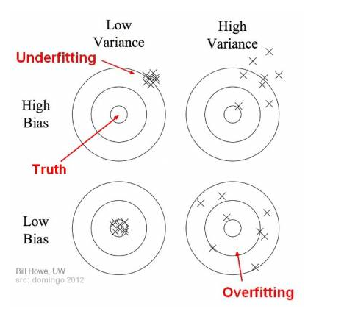
Bias and Variance

Slide 19
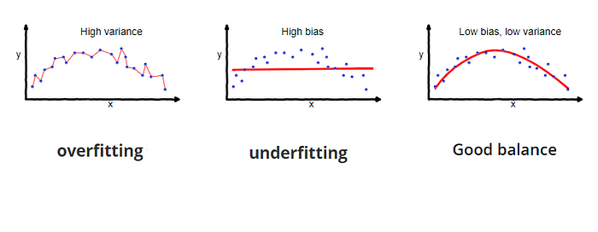
Bias-variance tradeoff
Model captures noise along with underlying data pattern
Model fails to capture underlying data pattern
Model captures underlying data pattern and is robust to noise
Source: https://towardsdatascience.com/understanding-the-bias-variance-tradeoff-165e6942b229

Slide 20
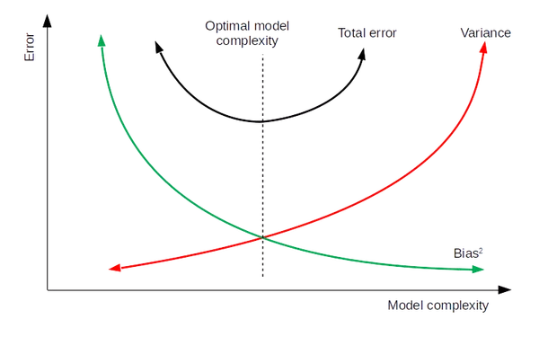
Bias-variance tradeoff
Bias
Optimal Model Complexity
Total Error
Variance
Error
Model Complexity
Source: https://towardsdatascience.com/understanding-the-bias-variance-tradeoff-165e6942b229

Slide 21
Machine learning models
Complexity
Interpretability
Type | Name
Linear | Linear regression
 | Logistic regression
Tree-based | Random Forest
 | Gradient Boosting
Neural Network | Neural Network

Slide 22
Assessing model performance

Slide 23
Assessing model performance
1
2
Y, X₁, X₂, X₃, …, X_{n}
3
80%
Y, X₁, X_{2,} …, X_{n}
TRAIN
TRAIN
Samples
Y, X₁, X₂, X₃, …, X_{n}, Y_{p}
BUILD/TUNE MODEL
20%
TEST
4
TEST
TEST MODEL
Y_{p}
YES
NO
5
EVALUATE PERFORMANCE
Y
YES
34 | 6
3 | 50
NO

Slide 24
Assessing model performance – Cross validation
Y, X₁, X_{2,} …, X_{n}
Y_{p}
Y, X₁, X_{2,} …, X_{n}
TRAIN (80%)
TEST (20%)
Samples

Slide 25
Types of cross validation
TRAIN
TEST
Holdout validation
K-fold cross validation
Leave-one-out cross validation
80%
20%
K-1 Folds
1 Fold
x K
N-1
1
x N

Slide 26
Evaluation Metrics

Slide 27
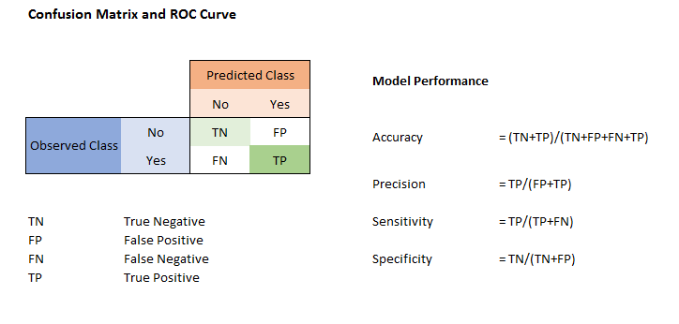
Evaluation metrics
How many of the predicted positive cases are truly positive?
How many of the positive cases are detected?
How many of the truly negative cases are predicted negative?
Source: http://scaryscientist.blogspot.ca/2016/03/confusion-matrix.html

Slide 28
Evaluation metrics
How many of the predicted positive cases are truly positive?
How many of the positive cases are detected?
How many of the truly negative cases are predicted negative?
Source: http://scaryscientist.blogspot.ca/2016/03/confusion-matrix.html

Slide 29
Evaluation metrics
How many of the predicted positive cases are truly positive?
How many of the positive cases are detected?
How many of the truly negative cases are predicted negative?
Source: http://scaryscientist.blogspot.ca/2016/03/confusion-matrix.html

Slide 30
Evaluation metrics
How many of the predicted positive cases are truly positive?
How many of the positive cases are detected?
How many of the truly negative cases are predicted negative?
Source: http://scaryscientist.blogspot.ca/2016/03/confusion-matrix.html

Slide 31
Caution: evaluating performance in unbalanced data
Unbalanced data:
80% controls & 20% cases
Y | Y_{p}
0 | 0
0 | 0
0 | 0
1 | 0
0 | 0
0 | 0
1 | 0
0 | 0
0 | 0
0 | 0
Source: http://scaryscientist.blogspot.ca/2016/03/confusion-matrix.html

Slide 32
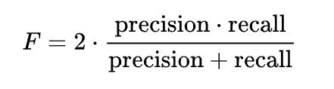
Caution: evaluating performance in unbalanced data
Unbalanced data:
80% controls & 20% cases
Y | Y_{p}
0 | 0
0 | 0
0 | 0
1 | 0
0 | 0
0 | 0
1 | 0
0 | 0
0 | 0
0 | 0
Is this a good prediction model?
Y = Y_{p} : 8
Y ≠ Y_{p} : 2
Accuracy = 8/10 = 80%
Precision = 0%
Sensitivity (Recall) = 0%
Choosing the correct evaluation metrics is critical
Source: http://scaryscientist.blogspot.ca/2016/03/confusion-matrix.html

Slide 33
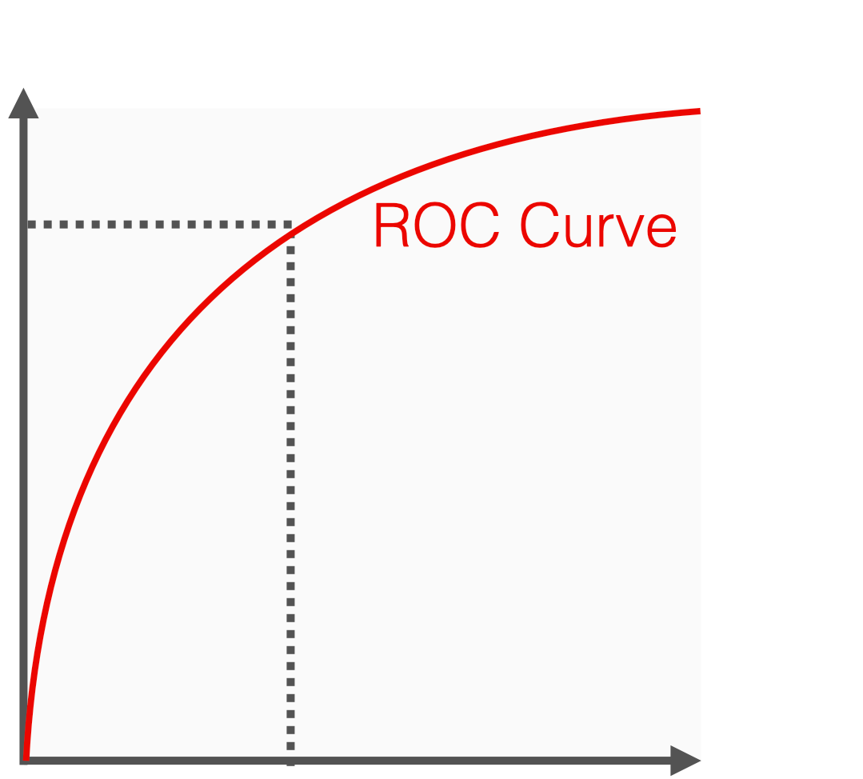
Receiver Operating Characteristic (ROC) Curve
Primarily used to evaluate threshold cutoffs to interpret continuous predictions as binary decisions.
Imagine we built a prediction model that predicts the probability of having a disease between 0-1. Consider the following thresholds:
3
1.0
2
True Positive Rate
0.5
1) X > 1: TPR = 0, FPR = 0
2) X > 0.5: TPR = 0.8, FPR = 0.45
1
3) X > 0: TPR = 1.0, FPR = 1.0
0
0
0.5
1.0
False Positive Rate
Source: https://www.evidentlyai.com/classification-metrics/explain-roc-curve

Slide 34
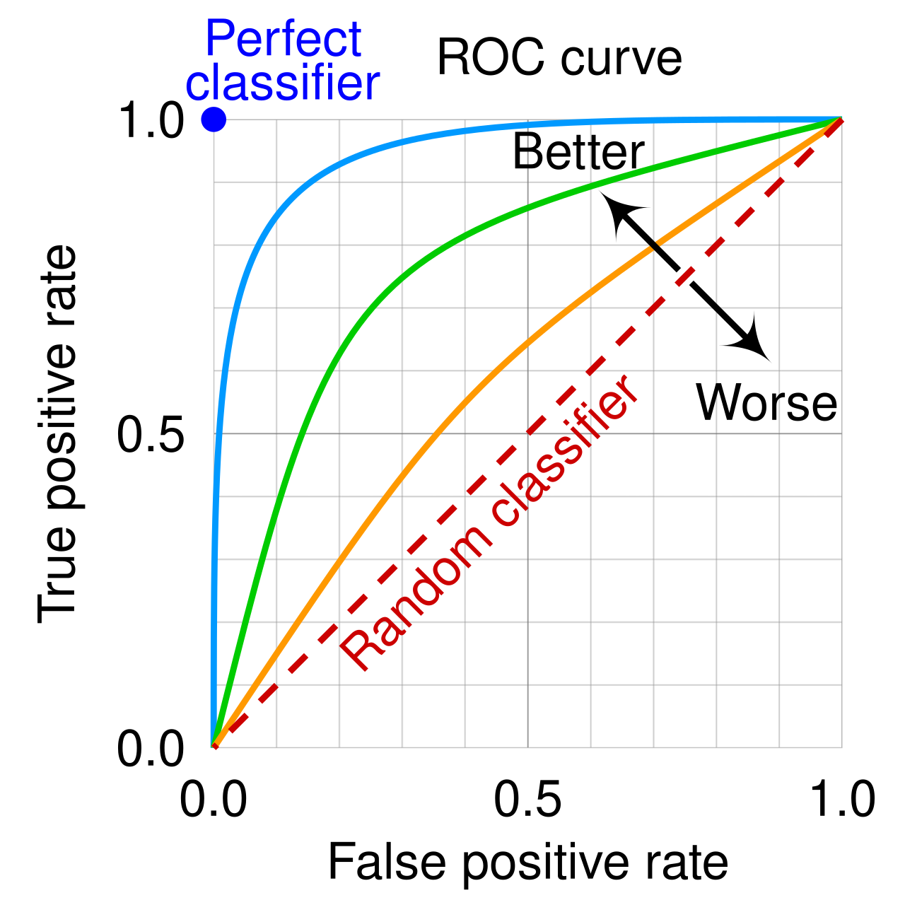
Receiver Operating Characteristic (ROC) Curve
Primarily used to evaluate threshold cutoffs to interpret continuous predictions as binary decisions.
Area under ROC (AUROC) is a measure of accuracy across all thresholds.
NOTE: Like accuracy, AUROC is inflated when evaluating unbalanced cohorts.

Slide 35
Pitfalls in applying machine learning

Slide 36
Often the main consequence of making a mistake in applying machine learning is, rather than receiving an error message, you get really good performance.
Whalen et al. Nat Rev Genetics 2022

Slide 37
1. Distributional differences between training, test and prediction sets
INCORRECT
TRAIN
TEST
PREDICTION
Multi-omics assays, i.e. RNA sequencing, run at different times, in different batches, can have different distributions, referred to as batch effects.
Batch 1
Batch 2
Batch 3
CORRECT
TRAIN
TEST
PREDICTION
Batch 4
Whalen et al. Nat Rev Genetics 2022

Slide 38
2. Relationships between examples can bias performance
INCORRECT
TRAIN
TEST
PREDICTION
MYC
FOXA1
MAX
MAD
Machine learning models expected features to be “independent and identically distributed” (i.i.d.).
However in biology, features in machine learning models are often related, e.g. protein families.
MAZ
FOXA3
JUNB
JUND
FOXA2
JDPL
CORRECT
TRAIN
TEST
PREDICTION
MYC
JUND
FOXA1
MAD
JUNB
MAX
FOXA3
JDPL
From the same protein family
MAZ
FOXA2
Whalen et al. Nat Rev Genetics 2022

Slide 39
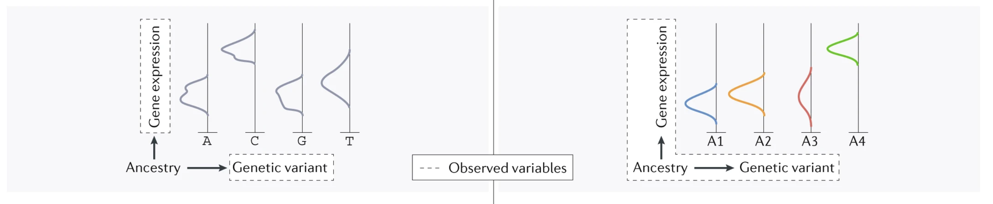
3. Unmeasured observations can confound inferred relationships
Sometimes there is an external variable that has not been measured that induces a relationship between two measured variables.
INCORRECT
CORRECT
Whalen et al. Nat Rev Genetics 2022

Slide 40
4. Information leakage between train and test sets
INCORRECT
Processed Training Data
Some data requires preprocessing, e.g. normalization of RNA-sequencing.
Preprocessing all data together results in information linkage.
Unprocessed Data
Processed Data
Preprocessing steps
Processed Testing Data
CORRECT
Preprocessing steps
Training Data
Processed Training Data
Unprocessed Data
Preprocessing steps
Processed Testing Data
Testing Data
Whalen et al. Nat Rev Genetics 2022

Slide 41
5. Unbalanced datasets can make fair evaluation difficult
INCORRECT
TRAIN
TEST
-
-
-
- +
- +
- +
-
-
-
- +
- +
- +
Test set should reflect expected distributions in prediction set.
TRAIN
TEST
TRAIN
TEST
CORRECT
-
-
-
- +
- +
- +
-
-
-
- +
- +
- +
-
-
-
- +
- +
- +
-
-
-
- +
- +
- +
OR
Whalen et al. Nat Rev Genetics 2022

Slide 42
This week: tutorial and flash updates
Tutorial:
We will be training and testing a machine learning classifier to predict breast cancer subtypes from RNA-sequencing.
Flash Updates:
Random Forest: Provide an overview of the Random Forest method for classification of complex data.
Logistic Regression: Provide an overview of Logistic Regression, a predictive machine learning method.
Natural Language Processing: Provide an overview of Natural Language Processing for turning text into data.

